Slide 1
Identity-Gender Poetry
YYGS LPC ll Capstone 2023
Dylan, Maria, Jack, and Hannah

Slide 2

Questions
As much as I was asked
By my loving father
And my cherishing mother
I could only see that the answer was masked.
Because how’s one to know
What gender means
How it feels
If it’s never safe to let it show.
I was questioned
I was asked
Yet every time I kept silent
Out of the fear of what gender could mean at last.

Slide 3
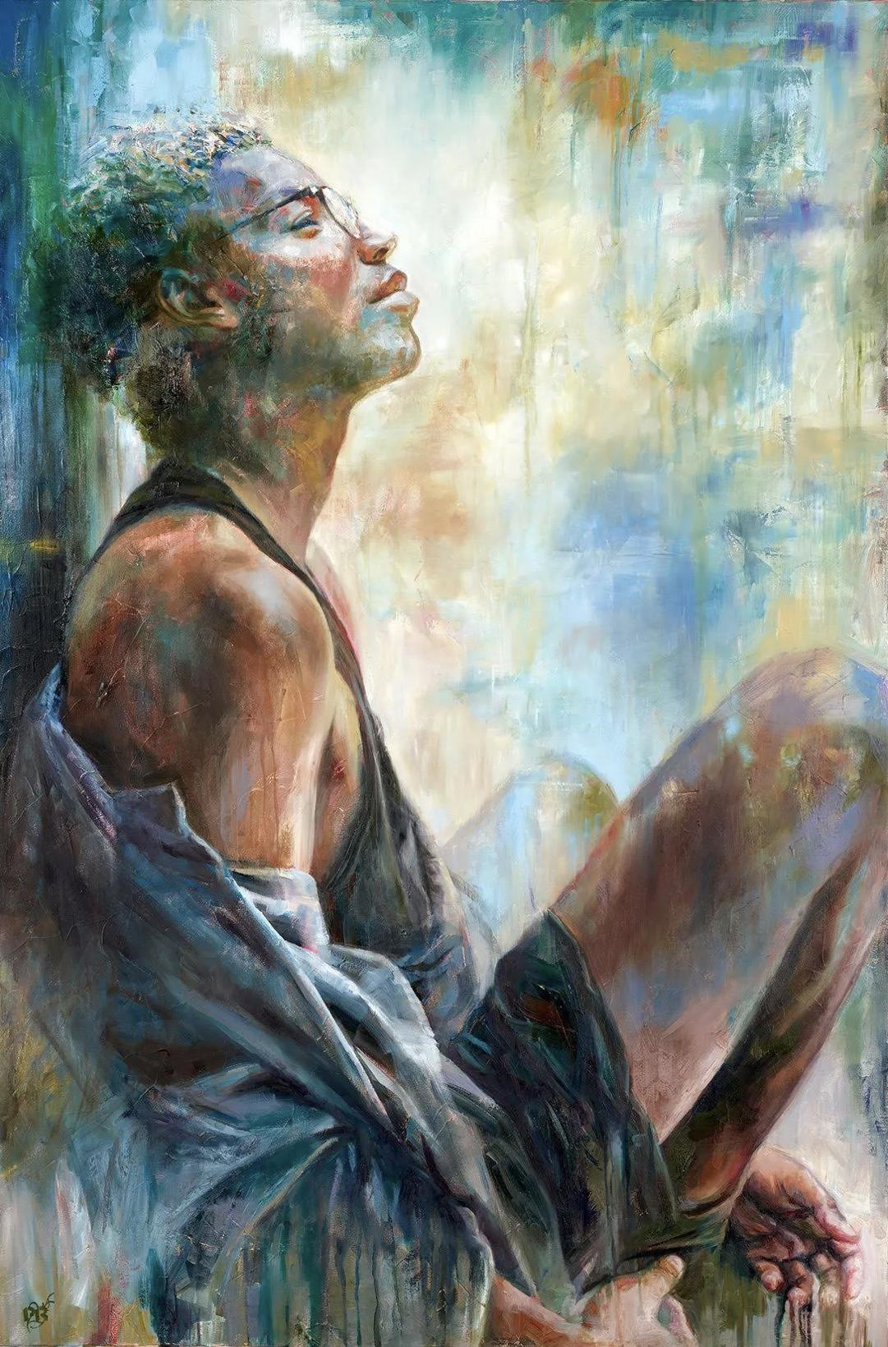
He
A word so short,
But so ubiquitous.
A word so charged,
But I lack the courage.
My confidence escapes,
As the memories return.
Woven so tightly,
To that designation.
Shame,
Shame,
Shame,
The bells of my mind ring.
Guilty, that I’ve chosen to betray
The gender of my face.
Richmond, 2018.

Slide 4

The abstract gender
Where I come from
There’s rampaging waves
A blossoming tree on each street
Beauty screaming from every wall
A woman dancing with fruit hanging from her arms.
“She’s gorgeous” my old grandfather would say
But was it truly her?
In a world in which nature reigns
Why does it seem so impossible to understand
The abstractness of gender,
If the abstract is all we see
In the branches of our trees
And the foam of our waves.
I can’t help but wonder…
The fruit seller,
Had she seen the abstractness within her?
Or was it kept invisible
By the waves,
The trees,
And the walls?

Slide 5

the Summit
To peak Mount Everest, you will pass the frozen remains of your brothers,
lashes crusted with snow, their pale skin gone rock-hard and red,
hands forever closed in a fist;
those boys are your landmarks,
they line the road to the Summit, to the height of your quest,
so you may be
the man on the rocks, crested crags by the cliffside
balance on stacks of stone, living for danger,
for sweat and for blood, glory and pride,

Slide 6
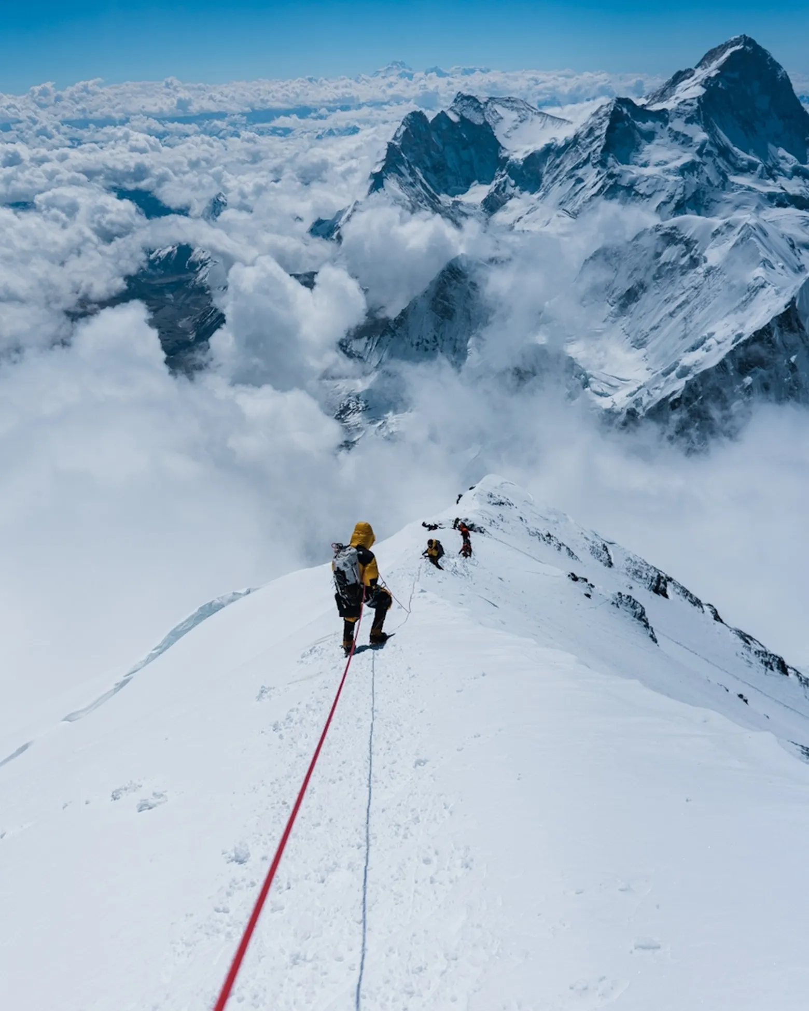
the Summit
so you might set the bar on the top of periphery
and wave the flag that marks the Summit
and the rest will fall on their way up,
down they'll roll and redden the clouds that rest around the stone.

Slide 7
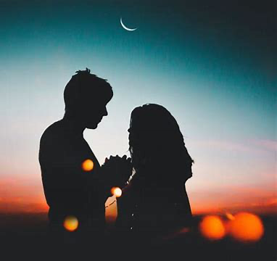
That boy
There is always a boy
A boy telling you never put on bright red lipsticks
You stop, and tell yourself you didn’t like the lipstick at all
A boy makes you sitting quietly and watch him playing video games
Observed how wise and valorous he is
A boy shouted at you when you make him awkward in front his friends
You're no more than a decoration that makes him outstanding
A boy teaching you how to be a real lady
Dress, smile, speak, walk appropriately

Slide 8
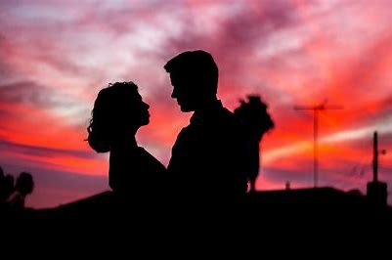
That boy
There is always a boy
A boy call you everything but your name
A boy rated you from one to ten
A boy who use “please” to warn you what to do
But, there shouldn't have been such a boy
shouldn't have been such a boy...

Slide 9
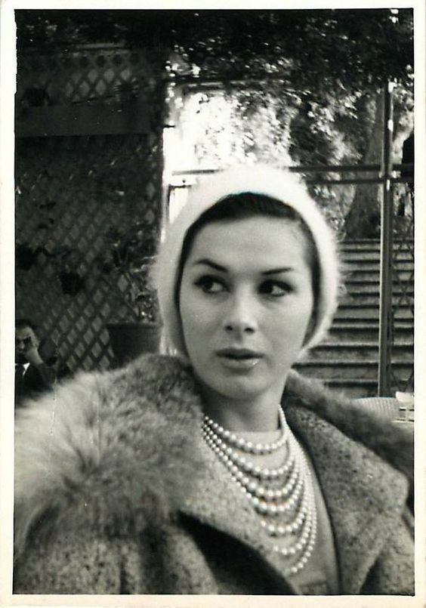
April
Sensationalised as an amusement,
A life was exposed
And there the trial started
In which a husband, an identity, and a soul, from her life were crossed
Oh how I wish your treasure wasn’t spoiled!
A woman who they saw as a man,
A soul who of its happiness was bereft
And a violation that other’s saviour became.
She had kept it for herself
She’d work to treasure
What so intimate for everyone is
And was for her a gem of identity.
But others came along
To corrupt her soul yet so tender
And as they screamed on what they never should’ve spoke,
She had no choice but to surrender.

Slide 10
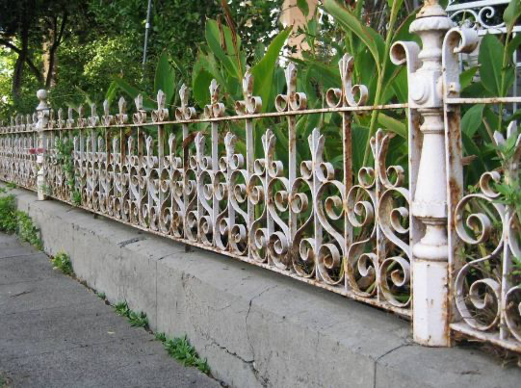
Untitled
Blue bathing suits that wade in the water
blend with the brisk running on the raised shores,
sweet like the sweat dripping into the waves
and working its salt back into the sea;
I am built of a metal that bends between gusts:
the kind that scrapes skies in the city.
Ornate, dark and chilled— the gates
that open to a garden, I am the garden,
I am the gate and I am the rust,
I am the keeper. I will let you in.

Slide 11
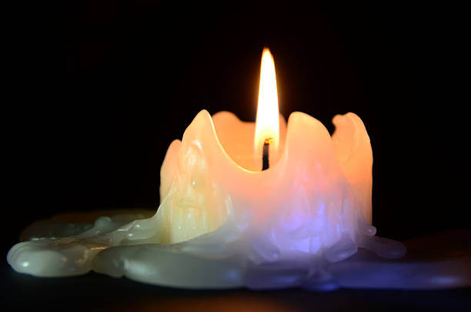
Untitled
I am wind-blown and smiley, blushing in
plum and not peach.
Shoulders not melting in the sun,
not spilling like wax by the fire,
liquid and slick.
Is it the bones that make me?
The beads of blood, of chromosomes and genes
that we pretend we all can read?
I know this skin better than you know it.

Slide 12
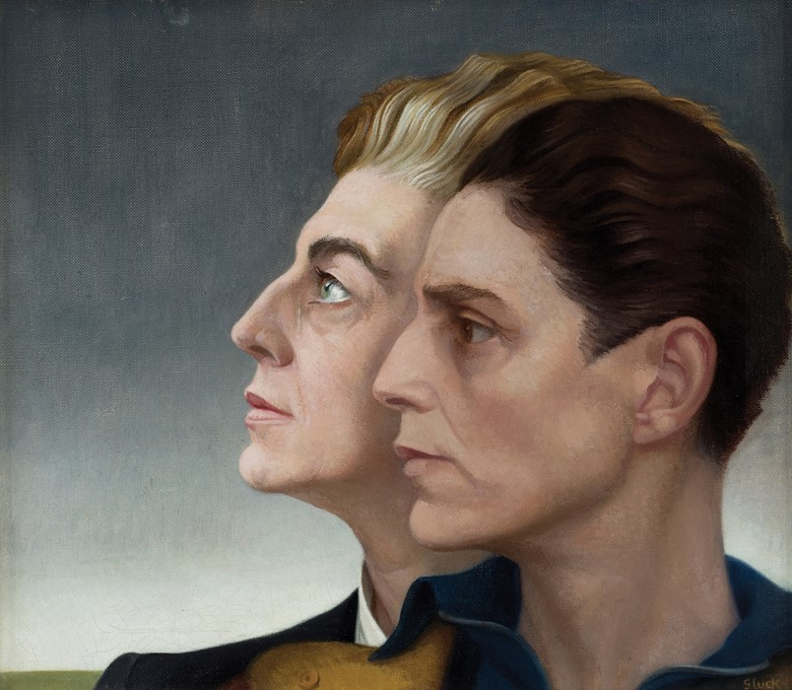
Middle ground
A script develops,
Of the defense I offer,
Whenever the inevitable arises.
Somewhere in the middle,
Just in between,
Not either.
And no, I’m not confused.
No longer is it the dread of justifying.
No longer is it the threat of ignorance.
It is now the lack of relief,
The hidden indignation,
When I’m allowed to move on.
Gluck, 1937.

Slide 13
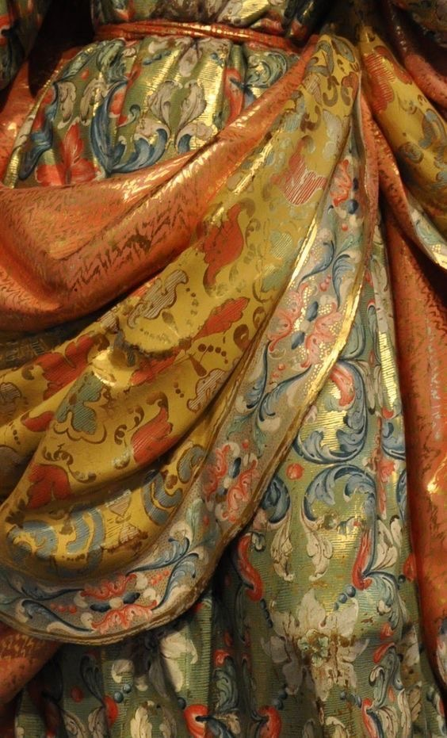
One day at a time
One day it’s what my parents will like
The next it’s what I’ll sit comfortably with.
One day it’s “you look so pretty my dear girl”
The next it’s “you’re not walking out the front door with that appearance, you’re living in a myth”.
Why is it that my family’s eyes light up
With the stars on my dress
Yet with the turn of one day
Their sight turns into a condescending glare
When to wear my brother’s clothes I dare.
But I’ve yet to discover what each day means.
And what each day will bring to my forever swinging soul
All I know is that with another sunset’s gore
I’ll turn with the mirror’s sight on these clothes of mine
And take myself one day at a time.

Slide 14
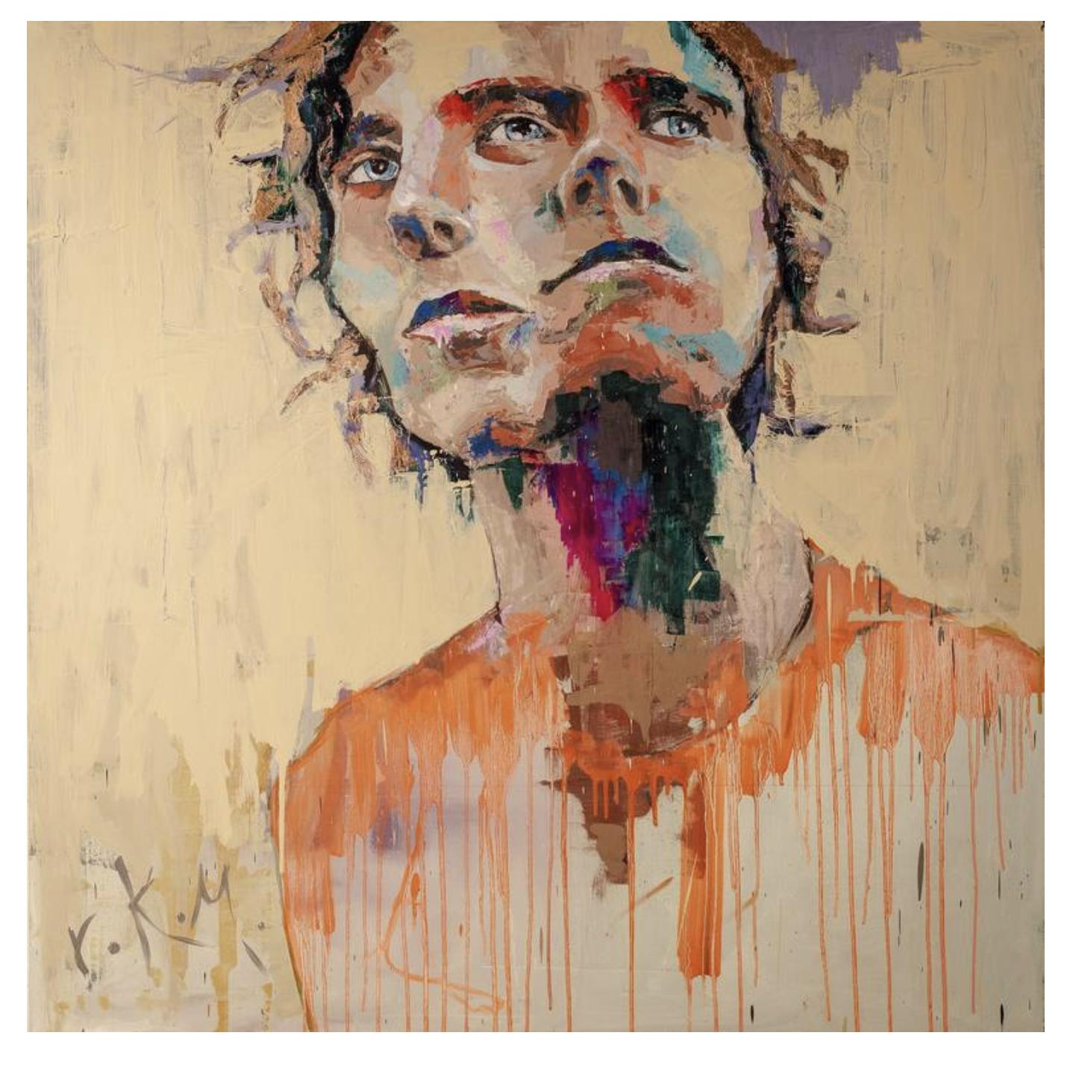
Opening Hours
Belonging
Acceptance
Understanding
Lead to my rejoice,
But only from nine till three.
Love
Warmth
Tolerance
Lead to my healing,
But only from nine till three.
Freedom
Self-determination
Independence
Lead to my euphoria,
But only from nine till three.
Four till eight,
Time for the mask,
Time for contentness,
In the face of distaste.
McHarg, 2021.

Slide 15
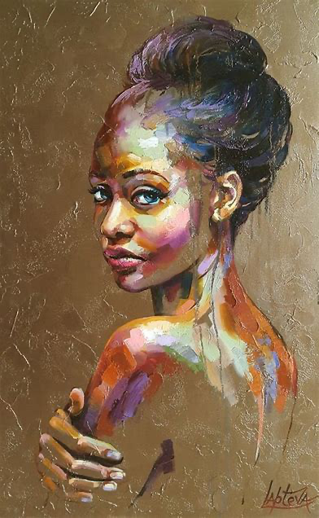
Being a “she”
“She” is a collection of millions of women for thousands of years
She has been destined since birth
She must make countless effort to fight against the many malice in the world
People around, even those thousands of miles away
They all jumped at her, trying to tame her
They locked her in a golden wire cage
Observe every action she made with satisfaction
Their hands pass through the cage, touching her golden feather
she strives to flap her wings
No matter it dyes her beautiful feathers blood red
She wants to return to her blue sky
But the “gentleman” said “it’s good for she to stay”

Slide 16
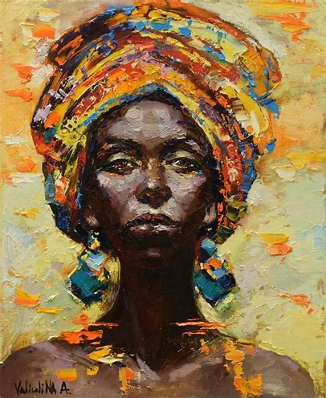
Being a “she”
For thousands of years
She was taught how to become a real lady
But the norm of being a real lady was determined by man
For thousands of years
She have been deprived of her real soul and rights
Not allowed to have personal achievements
For thousands of years
She is an item that can be owned by anyone but herself

Slide 17
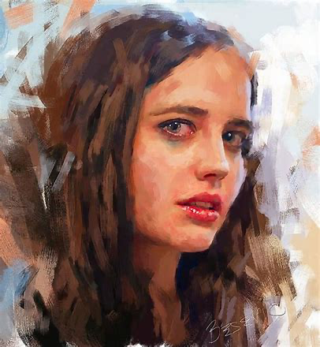
Being a “she”
But now, today
she don't want to keep silence
she don't want to bury her talent
she don't want to endure anymore
She don’t want to make any meaningless compromise
She want her body, her soul, and her thoughts
Only belongs to her

Slide 18
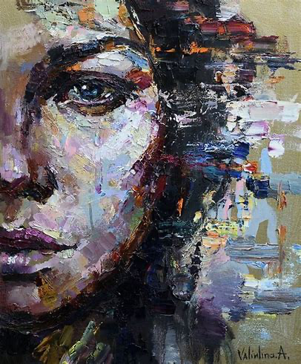
Being a “she”
She wants to lead millions of women who stand beside her
Step in to those fields designated as a “female forbidden”
She wants to create achievements that should belong to women
she wants to build an equal society for millions of women in future generations
A society capable of nurturing ambition and dreams
she wants the world to recognize
Women are born with soul, wisdom, and thought
Women are grand and powerful
She is here to break the constraints on women
No matter it is cultural, physical, or mental
She is here to retrieve what should have belonged to women
Equality and Freedom!

Slide 19
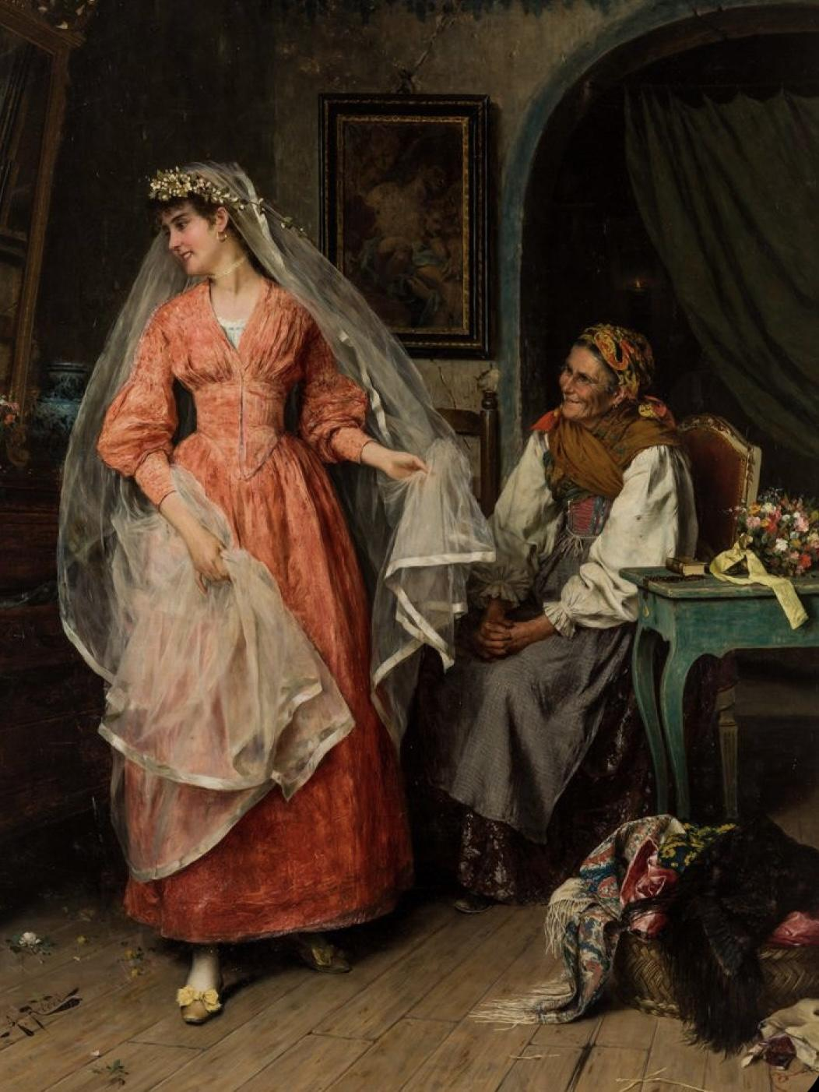
Ballads
Thumping piano
A rising sun
My dancing feet
And a warm hand on my back.
My eyes close like the sea
But everything clearly I see;
The roses surrounding me
And the grass singing a wedding ballad with glee.
A bird’s song awakens me
And my open eyes emerge
To look at myself in a crystal.
Through which my appearance and the warm hand submerge.
Who’s holding on to me?
Who am I, dancing at my wedding?
What is it that we’re missing
In this melting dream
If not our identity
And the voices that want to scream.

Slide 20
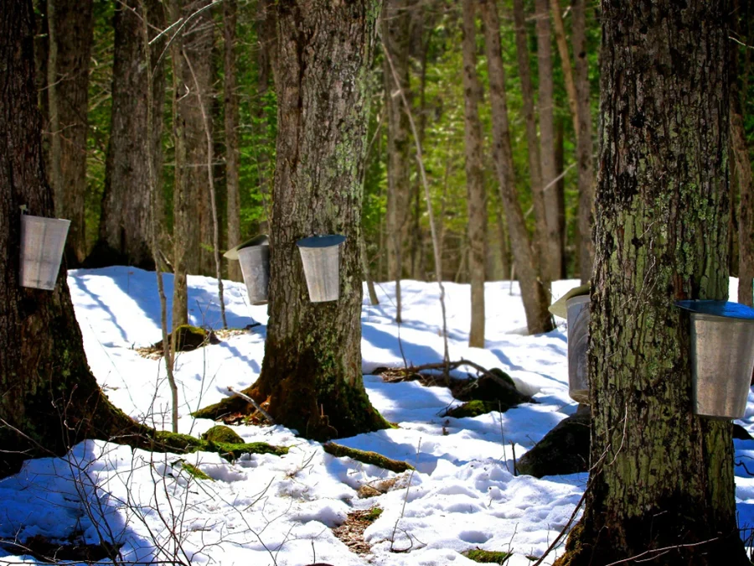
Scrapes
Scratch like you have nothing else to do,
pick at my scabs that seep with maple,
sap pooling in the heel of my shoe,
pulling on my skin like bark,
chipping 'til bare and seeming a sapling.
You, the lumberjack, ax at the ready.
I imagine how it feels to hold that weight in your hands,
how the calluses coat your palm and branch
until it pours over your nails, reaches your wrist.

Slide 21
Scrapes
I try to shake you like I'd shake off a bee.
I twist my face until the muscles braid to rope
and growl in hopes to scare you,
bearing the fur that wraps across my limbs,
the claws I keep between my fingers.
My breath is a stench that poisons,
and I breathe profusely.

Slide 22
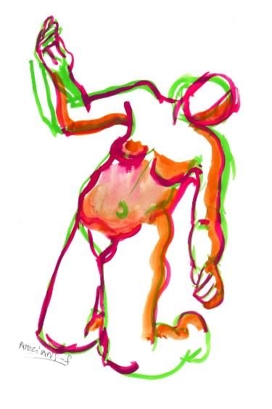
Can I keep walking?
Like thunder and buzz
Their words hit my legs
And though I can’t complain
My liveliness turns to rust.
And they keep asking me to explain
A reality that my limbs can’t comprehend,
So that my knees will keep trembling in a pain
That not even peace can mend.

Slide 23
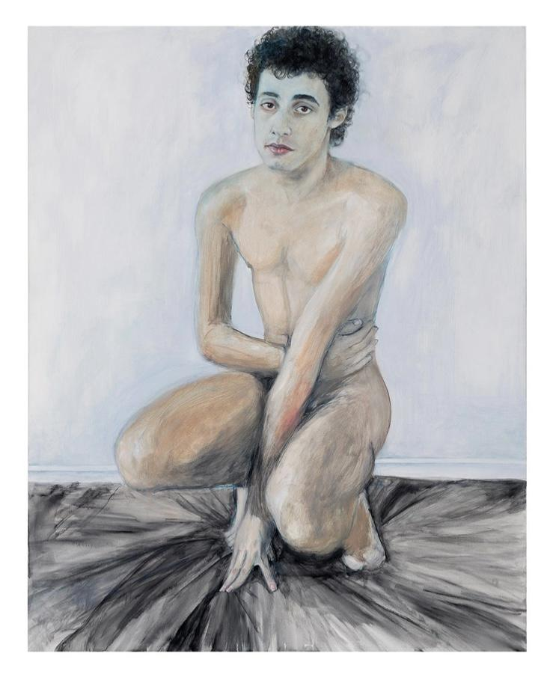
Assimilation
Observing so closely
As not to miss
The mannerisms,
Height,
Stance,
That make a man.
Listening so intently
As not to miss
The pitch,
Tone,
Views,
That make a man.
Feeling so intimately
As not to miss
The confidence,
Pride,
Self-assurance,
That make a man.
Rodrigue, 2018.

Slide 24
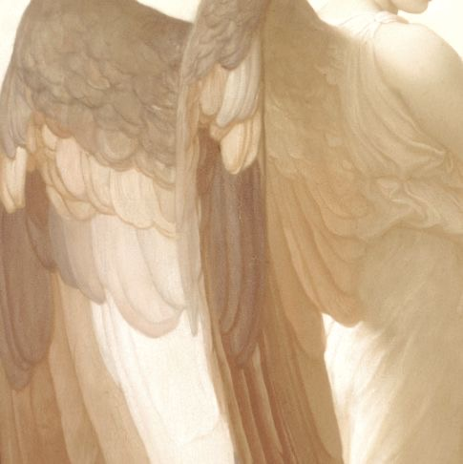
An angel flew by
Last Thursday night
I cried with all my might
Yet an angel flew by
Chanting that all my fears he’d fight.
His fallen fruit I took
And with a single look
My entire world he shook
When my anguish I saw written in a book.
“Hush, you’re a masterpiece as you are” he said.
Thus my brushstrokes seemed to mend
And from the invisible ghosts I no longer had to defend
An identity that oh so long I’d tried to bend.

Slide 25
Untitled
She was born in shackles.
Using her clear eyes gazing at this rusty era.
There is a red secret hidden in her foot binding cloth.
There is screaming stuck in the cracks of her bones,
She was broken and then pieced into a deformed arc.
When you turn your head
You will see them jumping with joy
Using plump vocabulary,
Praise this unparalleled art.
The rules of the world will be absolutely majestic,
Carved into her bones.
She crawled at her father's feet,
Pleading for her husband's forgiveness
She gave birth to nine children
Eight girls with same faith as her
And a son who will be someone’s father and husband

Slide 26
Untitled
She has a moldy book in her stomach,
She has a 30000 mile road in her eyes,
There are also clumsy women who have been confined to a floral jacket for her whole life.
They were killed by the world,
No one survived.
Those women.
Soft, obedient, silent
Using her prime time of life
Nurturing their desires.
When he was finally died
He mercifully
Grant her the right to choose between life and death.
She has been drowned in the water,
Someone sang a mournful song for her short life
She sank in the cold, with torn lungs.
Countless ghosts float up after her death.
Under the calm water, she trembling and squeezing out a dense roar
—Chastity！
She tried to shake her arms and shout,
But what the world receive is
A five thousand years of silence.

Slide 27

The brave soldier who shot another heart
I sent home the weapons
That so long had I gathered
And though I tried, tried, tried,
I can’t change that,
And I can’t change you.
So together we’ll cry, cry, cry
A song greater than the rest
For although my eternal friend
My arms won’t wrap around you
And my soul can’t pass your test.
And though on the surface we’re not that different
I can’t change what’s beneath.
So I hope you’ll pour mercy on me
Because when you know, you know.
Now I’ll deal with lonely shadow dances
To a solo song
While you yearn for something that wasn’t there.
Just know that I still scream when I see my arrow
With which I only shot another heart.

Slide 28
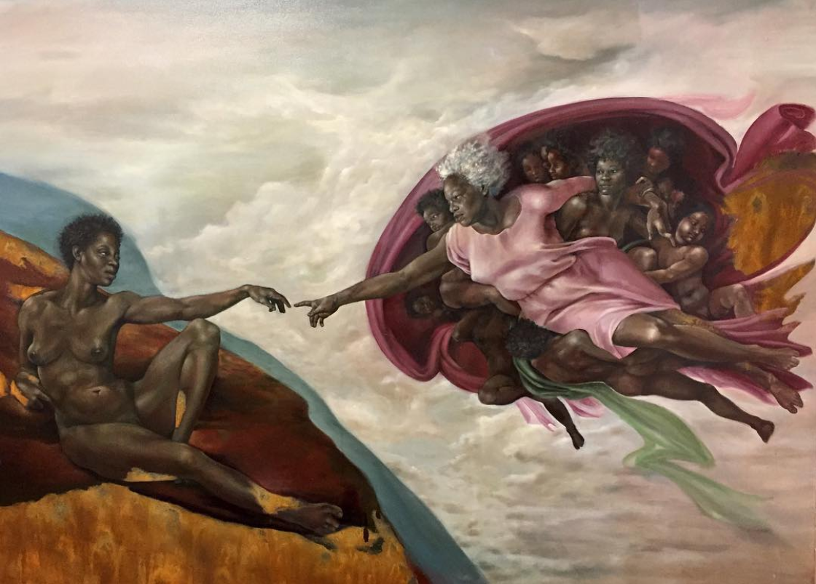
Power
She makes the boys cry
Who soften in front of her
She makes the boys cry
To whom she dares to say no
She makes the boys cry
Who tell her that she is beautiful
She makes the boys cry
And she is right
(Inspired by an excerpt from Vendredi sur Mer’s
Larme à gauche, translated from French)
Rosales, 2017. Adaptation of Michelangelo’s The Creation of Adam.

Slide 29
Lottie on the Line
Lottie's got the lots leaning low
and leading down, like luring lines
she's licking on and falling for,
she's lifted up and feeling cool currents
on her neck, too cold for her to bear,
ripping hair, her skin is wared.
The water's logging up her lungs,
and Lottie has no argument,
no rebuttal for rebuke,
her thoughts are cluttered and akimbo
and collected into shouts and grunts
and screams that pierce no plastic bags,
they're hardly even heard.
Lottie's on the line
of a side she cannot fall in.
The sea calls deep to heart
and coaxes like sleep medicine.
Lottie will not be the same
as she was yesterday.
Lottie lifts her finger light and
digs down into the dirt.
She finds treasure in the sand.

Slide 30
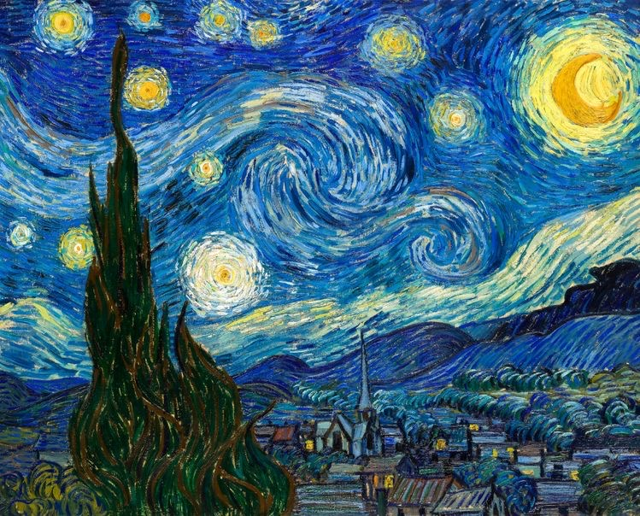
A fear of stars
And in that moment that I find myself
Maybe the stars won’t scare me as much.
I’ll sit in silence and look up
at their contrast on the night sky
And hope I won’t scream
But thank them for their light.
For difference scares me
As does standing out
But the moment I see myself as I am
And love my contrast
Then possibly I’ll glow with strength
And light the city of stars.

Slide 31
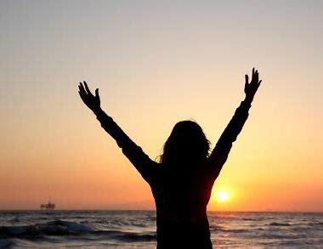
Don’t praise me
Don’t praise me,
I am beautiful, but not for your satisfactory
Don’t praise me,
I am capable, but not as a housewife who withstand your angry face from work
Don’t praise me,
I am tender, but that not the reason to keep me silence
Don’t praise me,
I am shapely, but that shouldn’t be the way we’ve been present in movies

